Slide 1
Gripping Presentation
Cheat-sheet & tools
© 2015 Oleksiy Rudenko
Oleksiy.Rudenko@gmail.com,

Slide 2

Will this presentation meet your needs?
What to put in?
What to leave out?
Need to prepare a presentation!
What to start with?..
What’s the proper order of slides?
How to grab their attention?
Are there any tools that can make my life easier?
What style to choose?
Do you share any of these concerns?
Then go ahead and find the answers!

Slide 3

How easy it is?
Expertise required
What will you learn & get?
Practical grip on building presentations
Certain presentation experience
Scholar and/or empirical knowledge of project workflow
Presentation planning
Collecting and structuring data
Building presentation skeleton
Testing yourself and improving presentation
Keeping grip on audience bringing succession in your story
Using tools & tools per se
Course profile
Expertise required
Time required
Difficulty level
2 hrs
Beginner
Pro
Expert
Guru
Easy
Difficult
Hard

Slide 4
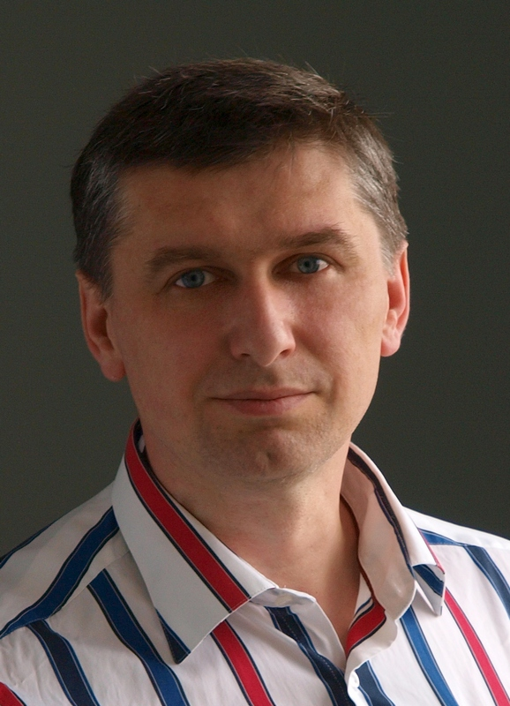
Author
Major expertise:
Business development
Areas of specific expertise:
PM, Leadership, CRM, IT, Insurance
Project related experience:
Project/program sponsor, manager, contributor, team member.
Managed, supervised, mentored dozens of projects of different scales.
Rate of formal presentations production:
At least one every month
Latest employments:
UNIQA Insurance Group member company
since August 2009
Oleksiy Rudenko
LL.M., M.Ec.
oleksiy.rudenko@gmail.com
http://fb.com/oleksiy.rudenko.5
http://linkedin.com/in/oleksiyrudenko
“Efficient tuition is reinforced with practical tools.”
“We are doing presentations every time we communicate. Even when just chatting.”

Slide 5
License
Use
Original @ github
Mention copyright ( O.R. o.r@gmail.com

Slide 6
Content
Section | What will you learn?
Intro | Rehearsal of some presentation basic principles
Workflow | Efficient approach
Instruments | Cheat-sheets, tools & examples
Life-hacks | Few productivity life-hacks
Sources | Useful sources of knowledge

Slide 7
Content
Section | What will you learn?
Intro | Rehearsal of some presentation basic principles
Workflow | Efficient approach
Instruments | Cheat-sheets, tools & examples
Life-hacks | Few productivity life-hacks
Sources | Useful sources of knowledge

Slide 8
Content
Section | What will you learn?
Intro | Rehearsal of some presentation basic principles
Workflow | Efficient approach
Instruments | Cheat-sheets, tools & examples
Life-hacks | Few productivity life-hacks
Sources | Useful sources of knowledge

Slide 9
Workflow
Targets
Main idea / message
Audience
Attention focus
Call to action
Decide: do you need an author’s page
Clip-art or photo
Charts etc
Structure
Initial situation / problem – Actions / Solution – Anticipated result
Arguments
Scalability
? slides
Content
(slides)
Conciseness
Style
Pictures vs Clip-art
Deployment
Rehearsal
Test run-through
Check equipment

Slide 10
Workflow
Map workflow on PM process

Slide 11
1. Purpose
What would you like to talk about?
People
Functions
1
2
Topic
Target group
2. Target group
Knowledge level
Technical competence
Prejudices
Attitude to topic
Needs
Fears & concerns
Wishes
[personal/professional]
Why topic is important – today & here for this target group?
3
4
5
Attitude
Interests
Relevance
3. Desired outcome
In single sentence – what should group learn or understand.
What benefits target group benefits specifically if they follow you?
What should the target group DO now?
Support, decide, approve.
Perfect if measurable.
Core message
6
Benefits
8
Goal
7

Slide 12
Targets Definition
1. Purpose
Example
2014/Q2 results
2014/Q3 planned actions
My team
1
2
Topic
Target group
2. Target group
Involved & engaged
Experts
Positive
How KPI convert into bonuses?
Will there be any declination in activities?
We need clear action plan based on current situation.
3
4
5
Attitude
Interests
Relevance
3. Desired outcome
Targets are challenged with issues. Need to adjust our plans.
1) Adapt to the market
2) Bonuses paid
Action plan.
Core message
6
Benefits
8
Goal
7

Slide 13
Choose Appropriate Format
4. Communication content and style
Formal
Info
Pitch
Informal

Slide 14
Choose Appropriate Format
4. Communication content and style
 | Info | Pitch
Story | Information & facts | Dynamic storyline addressed to personal needs
Visualization | Clear bullets, charts or tables | Pictorial slides. Requires high efforts to collate.
Standalone
Tuition Presentation
(read and learn)
Formal:
High effort – win or loose.
Info:
Share.
Discuss.
Pitch:
Activate the audience.
Win.
Informal:
Low effort.
Staged
Tuition Presentation
(listen, watch and learn)

Slide 15

Choose Appropriate Format
Examples
4. Communication content and style
Formal
Planning session
Strategy discussions
This presentation
Info
Pitch
Wide audience technology presentation
Visionary
Informal

Slide 16
Information Collection
5. Brainstorming
Group A headline
Group B headline
Group C headline
6. Structure into groups – logic check
7. Find headlines for groups

Slide 17
Information Collection
Example
5. Brainstorming
Current Situation
Business Environment & its impact
Challenges
Sales
Market
Operational risks
KPI break-down
Sales Prognosis
You may find appropriate to move certain items to e.g. action plan.
6. Structure into groups – logic check
7. Find headlines for groups

Slide 18
Presentation Skeleton
START
Topic/Headline
Relevance
Interests
Core message
Speaker
presentation
1
5
4
6
AGENDA
Headline 1
Headline 2
Headline 3
Sub-item 1.1
Sub-item 2.1
Sub-item 3.1
BODY
Sub-item 1.2
Sub-item 2.2
Sub-item 3.2
Sub-item 1.3
Sub-item 2.3
Sub-item 3.3
FINISH
Core message
Conclusion
Goal / Next steps
Benefits
Close
=6
7
8

Slide 19
Presentation Skeleton
How to complete
START
Topic/Headline
Relevance
Interests
Core message
Speaker
Presentation
Do you need it?
1
5
4
6
AGENDA
Headline 1
Headline 2
Headline 3
These are headlines from Data Collection
Sub-item 1.1
Sub-item 2.1
Sub-item 3.1
Take slides from Targets Definition.
Take slides from Targets Definition.
BODY
These are major points from Data Collection
Sub-item 1.2
Sub-item 2.2
Sub-item 3.2
Sub-item 1.3
Sub-item 2.3
Sub-item 3.3
FINISH
Core message
Conclusion
Goal / Next steps
Benefits
If we employ this action plan we shall win…
I want you to do the following…
=6
7
8

Slide 20
Build discussion
Headline
The topic today is…
(or provocative question)
Situation
Negative consequences
What are the facts?
What’s causing the problem?
If no [effective] corrective action is taken…
Objective
Proposal
Positive outcome
The most important thing is… Right?
My/our proposal is…
The benefit for you/us is…
Next steps
Here is the plan…
Conclusion
Answer to headline. Close.

Slide 21
Start & Finish
START card
Tune yourself I am positive… I keep things short…
1. Topic Today the topic is…
2. Relevance It’s important for you because…
3. Interests You as a…
4. Core message You will see that…
5. Introduction Name/Position/Competence | Better to get introduced by someone else
FINISH card
1. Bridge to Q&A Which information…?
Q&A Session
2. Core message As you have seen…
3. Next steps/Goal Now we… / The goal is…
4. Benefits You will gain…
5. Close/Question Finally…

Slide 22
Start & Finish
START card
Tune yourself I am positive… I keep things short… | Smile to audience. Make a pause. Off!
1. Topic Today the topic is… | Today’s topic is e-learning.
2. Relevance It’s important for you because… | It’s important because we have tough times, ought to save money, while we still want to deliver knowledge to our sales force.
3. Interests You as a… | You as professionals in charge for sales want to use efficient instruments.
4. Core message You will see that… | You will see that you can benefit a lot from e-learning.
5. Introduction Name/Position/Competence | Better to get introduced by someone else My name is Oleksiy. I am a Head of Sales Development in…
Example
FINISH card
1. Bridge to Q&A Which information…? | What information you need to start planning e-learning launch in your company?
Q&A Session
2. Core message As you have seen… | As you have seen you can enhance your sales force in an affordable manner.
3. Next steps/Goal Now we… / The goal is… | So, the next step is to draw an e-learning implementation plan.
4. Benefits You will gain… | Having e-learning implemented you shall improve your KPIs. Such as productivity, sales quality, GWP.
5. Close/Question Finally… | Can we do first steps towards better productivity today?

Slide 23
Lifehacks
PPT Template with design & visuals preset, include author’s page – it’s easier to remove than to find & copy (re-create) recurring typical slides.
Add ppt planning tools.
Never delete slides – move them beyond main scope.
Make a “final” version before deployment. Remove unnecessary slides at production stage.
Filename – Category – Topic – Author (version language) // version == YYMMDD

Slide 24
Useful sources
http://www.hps-training.com/en/
What are Signposts and Why are They Important? http://businessenglishresources.com/31-2/student-section/student-handouts/signposts-test/
Keys to Effective Formal and Informal Presentations http://wps.pearsoncustom.com/pls_1256647969_pwo/217/55693/14257453.cw/content/index.html

